Slide 1

Corneal Endothelium Imaging Using Optical Coherence Tomography
Pradipta Mukherjee
Computational Optics Group, University of Tsukuba

Slide 2
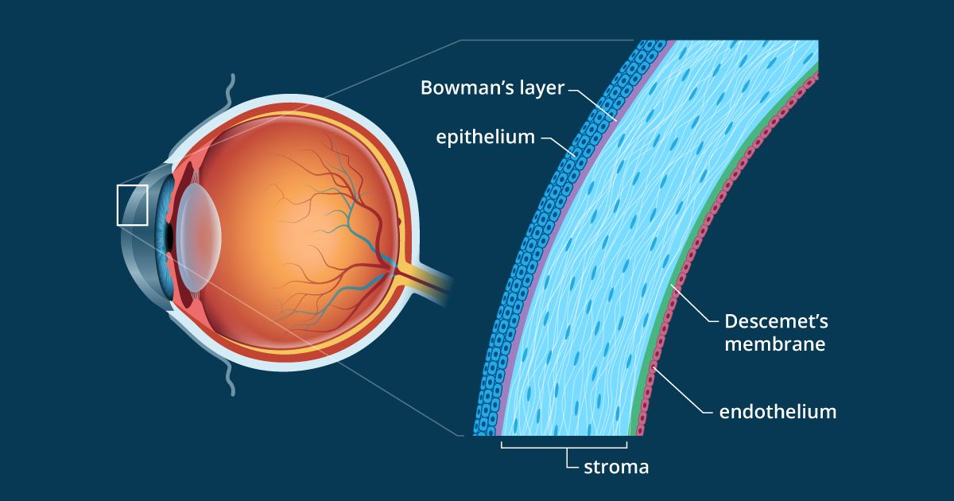
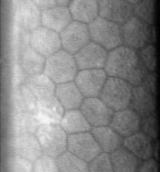
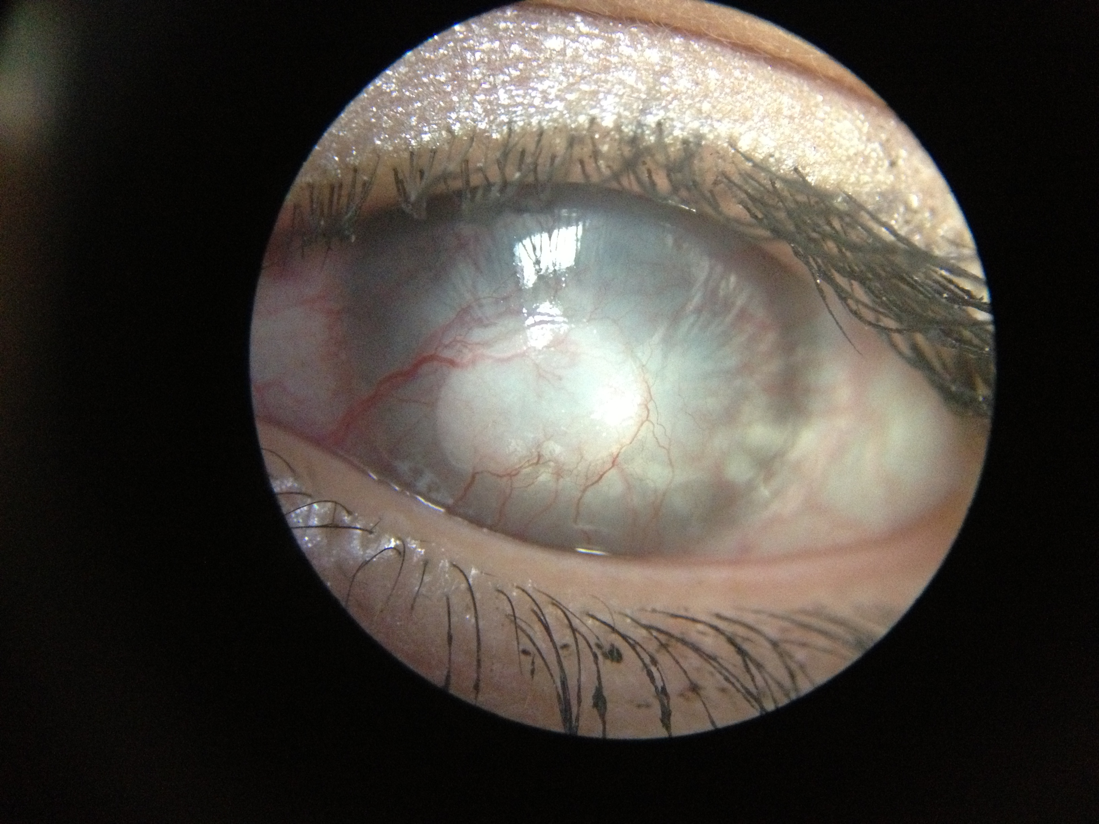
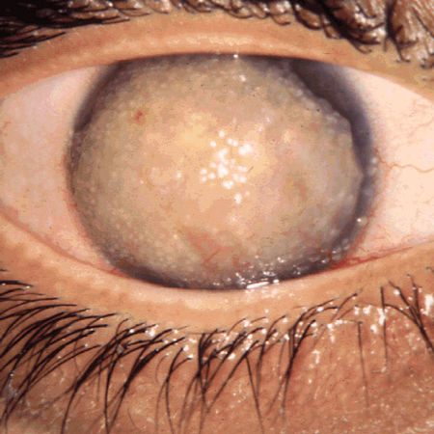
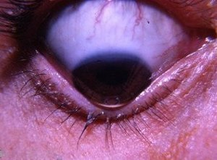
Cornea and its diseases
Cornea endothelium
Monolayer of hexagonal cells
Source: Wikipedia
Plays crucial role for homeostasis of Cornea
https://www.allaboutvision.com/resources/cornea.htm
Dysfunction
Cornea Opacity
Dystrophy
Keratoconus
Cornea transplantation
Selective endothelial replacement
i.e. endothelial keratoplasty
Surgical treatment
Source : Wikipedia

Slide 3
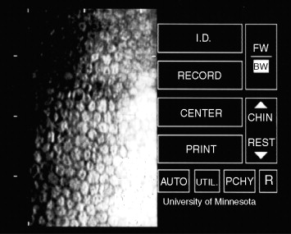
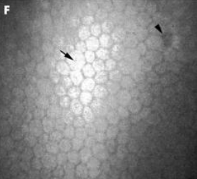
Current standard techniques
Specular Microscopy
Kaufman, Encyclopedia of the Eye, 2010
✘
Unable to evaluate all layers of cornea
In-vivo Confocal Microscopy (IVCM)
✘
limited field of view
✘
limited field of view
✘
Two-dimensional imaging
✘
Requires contact to the eye to achieve high numerical aperture
Optical Coherence Tomography
Jalbert Br H Opthalmol, 87, 225- (2003)
✔
OCT is non-invasive wide field of view imaging modality
Challenge: Achieving a large FOV of corneal endothelium in vivo

Slide 4
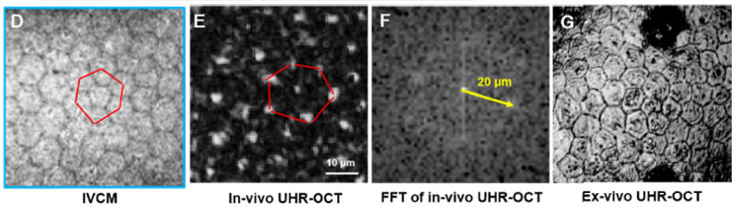
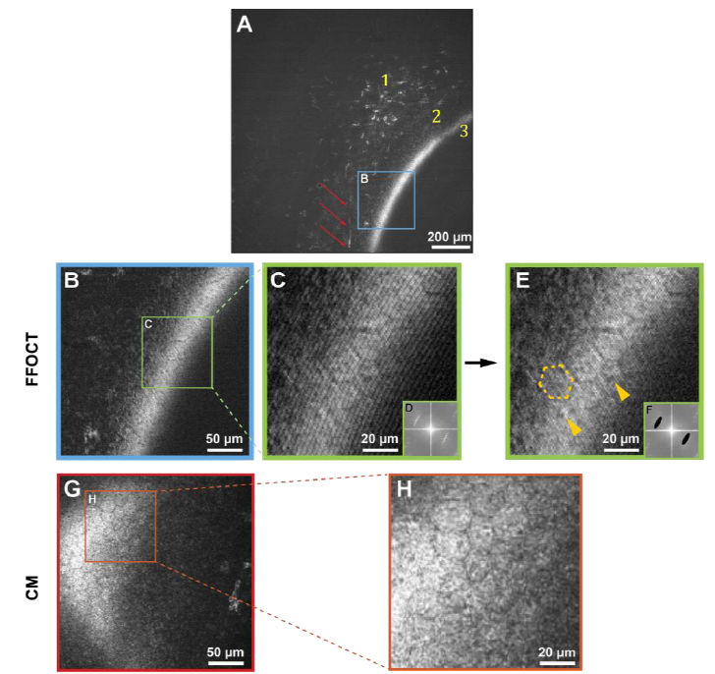
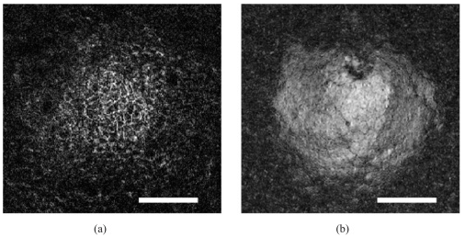
Recent OCT based study on cornea imaging
SD-OCT (OCM), A-line rate- 250KHz, Human cornea
Full-field OCT, en face frame rate – 300Hz,
Human cornea
B. Tan, Biomed. Opt. Express, 9, 6569– (2018).
Gabor domain OCM, A-line rate- 56KHz, Mice cornea
Mazlin, Biomed. Opt. Express, 9, 557– (2018).
Canavesi, Biomed. Opt. Express, 11, 711– (2020).

Slide 5
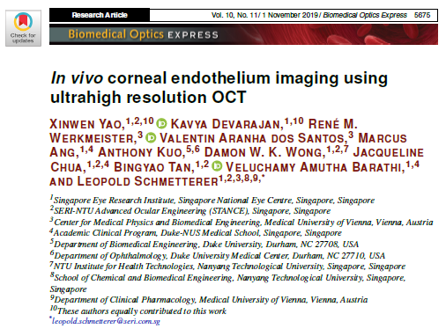
Corneal Endothelium imaging using ultrahigh-resolution OCT
Purpose:
Investigation of OCT system resolution on successful visualization of in vivo corneal endothelial cell images in a large FOV
Effect of lateral resolution (DOF, FOV)
Effect of Axial resolution
X. Yao, Biomed. Opt. Express, 10, 5675–5686 (2019).

Slide 6
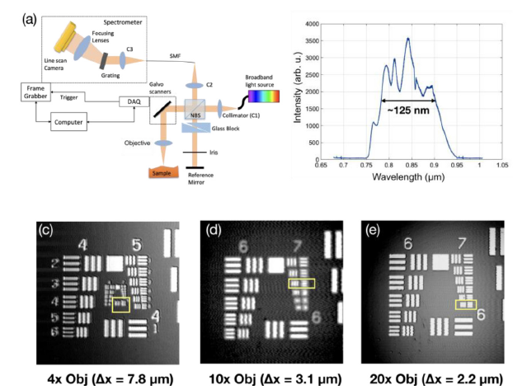
SD-OCT system
Light source:
Central wavelength: 850 nm
Bandwidth: 125nm
A-line rate: 70KHz
Axial resolution: 2.5 µm (air)
4X (DOF = 449µm)
10X (DOF = 71µm)
20X (DOF = 36µm)

Slide 7
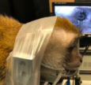
In vivo corneal endothelial cell imaging of monkey
Measurement protocol:
One adult cynomolgus macaque monkey at 4-6 years old is used.
In vivo imaging of corneal endothelial cells was performed on one eye (randomly chosen).
Anesthetized during imaging.
Positioned in the adjustable platform and its head secured to the OCT apparatus using parafilm strips to avoid large motion
Saline drops were applied in between the scans to keep the cornea moisturized.
After the OCT measurement, the same eye was imaged by IVCM .
The monkey was then sacrificed, and the eye was procured immediately to perform ex vivo OCT imaging at the same location within 2 hours.
After completing all the imaging procedures, the eye was fixed in formalin and sent for cross-sectional histology process.

Slide 8
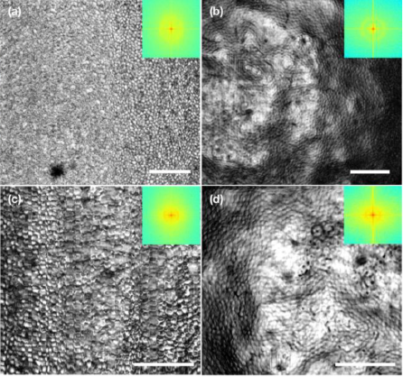
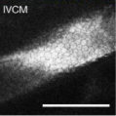
Effect of lateral resolution
OCT
10X objective
In -vivo
Ex -vivo
IVCM
FOV:
1.037 x 1.037 mm²
FOV:
0.691 x 0.691 mm²
Lateral resolution = 3.1µm
Scale bar- 200 µm

Slide 9
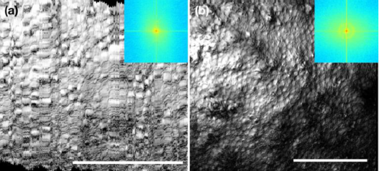
Effect of lateral resolution
20X objective
OCT
IVCM
In -vivo
Ex -vivo
FOV:
0.343 x 0.343 mm²
FOV:
0.510 x 0.510 mm²
Lateral resolution = 2.2µm
Scale bar- 200 µm

Slide 10
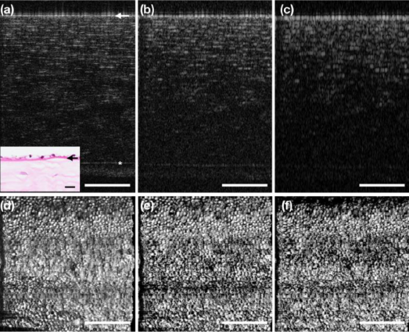
Effect of axial resolution
Axial resolution
2µm
4µm
8µm
Endothelium layer
Cornea inverted
Cross-section
Bowman’s layer
10X objective
FOV: 0.691 x 0.691 mm²
En face
Scale bar- 200 µm

Slide 11
Limitations
The OCT A-line speed was 70 kHz and the B-scan rate was 117 Hz. While it seemed to be sufficient for in vivo monkey imaging with motion management, it was too slow for human corneal imaging.
For human corneal endothelial cell imaging using conventional raster-scanning OCT, the highest frame rate up to date was 500 Hz, and that still it was not possible to visualize a large area of human corneal endothelial cells in vivo.
Therefore, an even higher OCT frame rate will be needed to fulfill this purpose. Since the axial resolution is not crucial for corneal endothelial cell imaging, it is also possible to employ the high-speed SS OCT with multiple MHz A-line rate.

Slide 12
Summary and Take Home Message
Performed a study to evaluate the optimal spatial resolution of OCT required for acquiring high-quality corneal endothelial cell images in vivo.
Lateral resolution : Crucial
Extended DOF can benefit for large FOV
Axial resolution: Not important for corneal endothelium imaging
Motion control or motion correction is required for in-vivo human cornea endothelium imaging.
Evaluation of functional property of Corneal endothelial tissue is required for the assessment of status of Cornea.

